Slide 1
Introduction to IB2D

Slide 2
IB2d
IB2d is useful for 2D simulations of flexible, moving boundaries at Re<1000.
There is both a MATLAB and a Python version of ib2d that can be downloaded here:
https://github.com/nickabattista/IB2d
The data may be visualized using Visit Visualization
https://visit-dav.github.io/visit-website/

Slide 3
IB2d References (developed by N. Battista)
N.A. Battista, A.J. Baird, L.A. Miller, A mathematical model and MATLAB code for muscle-fluid-structure simulations, Integ. Comp. Biol. 55(5):901-911 (2015), LINK
N.A. Battista, W.C. Strickland, L.A. Miller, IB2d:a Python and MATLAB implementation of the immersed boundary method,, Bioinspiration and Biomemetics 12(3): 036003 (2017), LINK
N.A. Battista, W.C. Strickland, A. Barrett, L.A. Miller, IB2d Reloaded: a more powerful Python and MATLAB implementation of the immersed boundary method, in press Math. Method. Appl. Sci. 41:8455-8480 (2018) LINK

Slide 4
IB2d Video Tutorials
Tutorial 1: https://youtu.be/PJyQA0vwbgU An introduction to the immersed boundary method, fiber models, open source IB software, IB2d​, and some FSI examples!
Tutorial 2: https://youtu.be/jSwCKq0v84s A tour of what comes with the IB2d software, how to download it, what Example subfolders contain and what input files are necessary to run a simulation
Tutorial 3: https://youtu.be/I3TLpyEBXfE An overview of how to construct immersed boundary geometries and create the input files (.vertex, .spring, etc.) for an IB2d simulation to run using the oscillating rubberband example from Tutorial 2 as a guide.
Tutorial 4: https://youtu.be/4D4ruXbeCiQ The basics of visualizing data using open source visualization software called VisIt (by Lawrence Livermore National Labs), visualizing the Lagrangian Points and Eulerian Data (colormaps for scalar data and vector fields for fluid velocity vectors)

Slide 5
Describing the boundary
In the immersed boundary method, boundaries are always elastic.
They can be stiff enough that they act like rigid objects.
They can be moved in prescribed ways using target points.
Boundaries have been modeled to resist bending, stretching, and twisting.
All of these properties can change in time in prescribed ways or according to other models.

Slide 6
Input files
What do the different input files do?
The input2d file includes a lot of information on physical parameters (density, viscosity, boundary conditions, domain size) and numerical parameters (dt, dx, printing intervals, etc.)
In addition to the input2d file, there are a number of files that specify the initial conditions and material properties of the immersed elastic structures.
The only such file that is required is the ".vertex" file, which specifies the initial positions of the IB points.
Notes:
*

Slide 7
Optional Input Files
There are several additional files that may be optionally specified:
A ".spring" file can be used to specify an essentially arbitrary network of springs that connect the various IB points. Each "spring" connects precisely two IB points.
A ".beam" file can be used to specify a collection of linear beams with a preferred curvature. Each "beam" connects precisely three IB points.
A ".target" file is used to specify IB points that are, by default, "tethered" by stiff linear springs to their initial positions. Note that it is also possible to update the location to which each target point is tethered to within a simulation, so as to provide an approximately-prescribed motion for the target points.
A ".mass" file is used to specify any additional mass associated with the IB points.

Slide 8
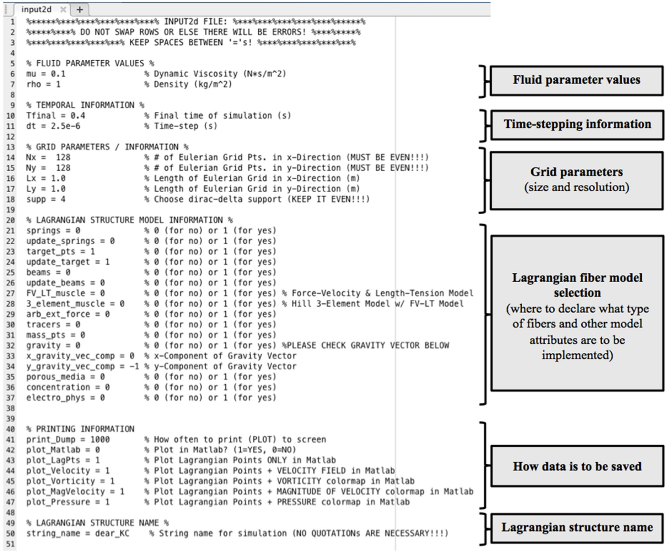
Input2d

Slide 9
Vertex File Format
Vertex input files end with the extension ".vertex" and have the following format for two-dimensional models:
N # number of vertices in the file
x_0 y_0 # (x,y)-coordinates of vertex 0
x_1 y_1 # (x,y)-coordinates of vertex 1
...
x_{N-1} y_{N-1} # (x,y)-coordinates of vertex N-1

Slide 10
IB2d boundaries
In IB2D, multiple boundaries are combined into one long list.
This means that you have to keep track of where one boundary ends and the next starts.
For example, assume you have two plates. Plate1 is defined by vertices 1-100 and Plate2 by vertices 101-200.

Slide 11
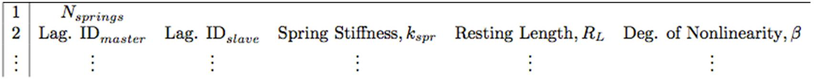
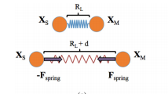
Spring File Format
Spring input files end with the extension ".spring" and have the following format:
Note:
A list of the master and slave nodes for each linear spring along with their associated spring stiffness, resting-length, and degree of non-linearity. Note that if using only Hookean springs, the degree of non-linearity can be omitted and IB2d will automatically assume linear springs.
There is no restriction on the number of springs that may be associated with any particular node of the Lagrangian mesh.

Slide 12

Target Point File Format
Target point input files end with the extension ".target" and have the following format:
The user provides a list of all target point indices with their associated target point stiffness.

Slide 13
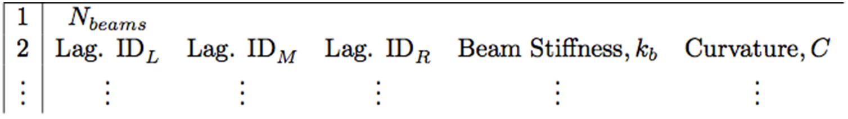
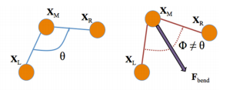
.beam file (torsional spring) format
Beam input files end with the extension ".beam" and have the following format:
This gives a list of the left, middle, and right Lagrangian indices associated with each torsional spring (beam) and their associated beam stiffness and curvature.

Slide 14
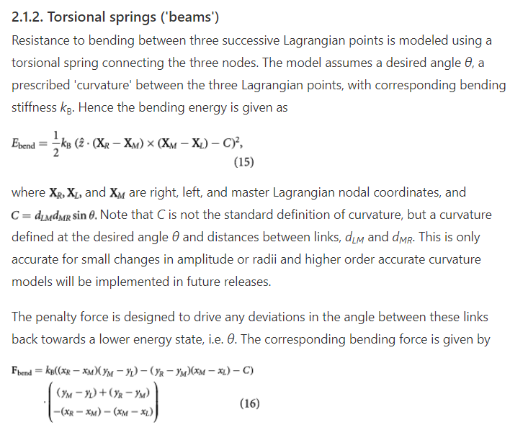
.beam file (torsional spring) format

Slide 15
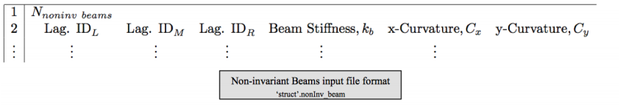
.nonInv_beam file (beam equation) format
Another way to model the resistance bending between three successive Lagrangian points (rather than using torsional springs) is by using a non-invariant beam connecting the three successive nodes. The model assumes a prescribed ‘curvature’ in both x and y components between the three Lagrangian points with corresponding bending stiffness k_{NIB}. The corresponding bending deformation forces are modeled as
F_{beam} = k_{NIB} ∂⁴/∂s⁴ (X(s, t) − X_{b}(s))
where X(s, t) is the current Lagrangian configuration at time t, e.g. the mapping of the Lagrangian points s to the underlying Cartesian grid, and X_{b}(s) is the preferred configuration of the fiber model.
This model is denoted as non-invariant beams since these beams are non-invariant under rotations, as opposed to the torsional spring fiber model. Similarly to the torsional spring model, non-invariant beam deformation forces can only occur on immersed boundary points on the interior or the fiber structure, not the endpoints.

Slide 16
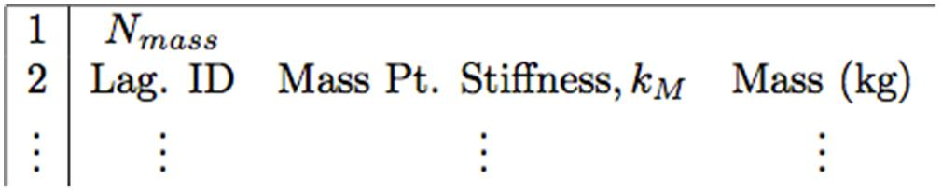
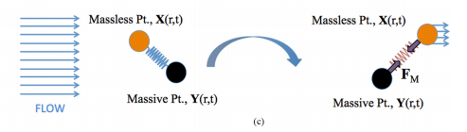
Mass point file format
.mass: A list of all Lagrangian mass point indices along with their associated mass-spring stiffness and mass.

